Slide 1

Eat2Beat
Reduce Food Waste project

Slide 2


Team Members
Nada Mansour
Amany Ashraf
Ahmed Gaber
Login Shagar
Reem Shouib
Yossef Khaled
Ahmed Salah
Shrouk Adel

Slide 3
Problem Context & Motivation
Restaurants often waste unsold prepared meals at the end of the day.
This food waste leads to financial losses and inefficient use of resources.
At the same time, many people struggle to access affordable meals.
There is no simple, organized system to manage and redistribute surplus food.

Slide 4


Problem Statement
Restaurants often throw away meals that weren’t sold, and there is no simple way to share them with people who could use them.
Eat2Beat Proposes Smart Food Waste Reduction by :
Our platform connects restaurants, users, and charities by offering easy meal management for restaurants, meal browsing and offers for users, and surplus food distribution for charities, with support for different deployment modes to fit each use case.
Stakeholders: Restaurants, users looking for affordable meals, and charitable organizations.

Slide 5

Learning & Technical Objectives
Smart Food Waste Reduction System
AI & Machine Learning for Food Management
Design and implement an end-to-end platform that reduces food waste by efficiently redistributing surplus food from restaurants to beneficiaries.
Provide mobile and web applications with clear, role-based user experiences.
Build and evaluate ML models to predict food demand and surplus, helping prevent overproduction.
Use AI-driven recommendations to optimize donation timing, quantities, and matching.
Compare multiple ML models to most suitable model for real-world deployment
Backend & System Integration
Analytics & Decision Support
Develop a scalable backend connecting mobile apps, dashboards, and AI services.
Integrate APIs to enable real-time data flow between frontend, backend, and ML models.
Visualize predictions, food surplus trends, and system performance.
Support data-driven decisions that lead to measurable reduction in food waste.

Slide 6





Expected Outcomes
Fully Functional System
Intelligent Decision Support
Complete System Integration
Mobile and web applications with shared features for managing food donations and requests.
A consistent experience across platforms for monitoring and coordination.
Trained and evaluated ML models
AI-driven recommendations and chatbot assistance to improve usability and efficiency.
Seamless connection between mobile app, web dashboard, backend services, and AI models
A working prototype demonstrating real-world deployment capability.

Slide 7




Expected Outcomes
Measurable Impact
Social & Technical Value
Clear performance metrics showing model accuracy and system effectiveness.
Visual analytics and reports enabling reduced food waste and optimized donations.
A scalable solution addressing food waste and food insecurity using technology.
A project that demonstrates industry-ready skills in AI, backend, and full-stack development.

Slide 8

Literature Review
 | personalized recommendation system | demand prediction model | Administrative part (Dashboard) | AI chatbot | Type of Service
Olio | ✅ | ❌ | ❌ | ❌ | Food - Non food
Too Good To Go | ✅ | ❌ | ✅ | ❌ | Baked goods only
Barkah بركه | ❌ | ❌ | ✅ | ❌ | All type of foods
Eat2Beat | ✅ | ✅ | ✅ | ✅ | All type of foods

Slide 9

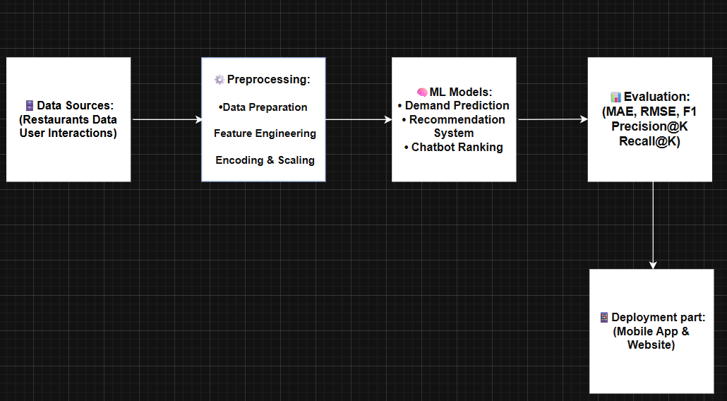
Proposed Solution Overview

Slide 10

System Architecture Overview
Eat2Beat is a food donation platform that connects users, restaurants, and charities through a centralized Cloudflare Worker API Gateway.
The gateway handles:
Authentication and role management using Firebase.
Business logic and data management through Supabase.
Image storage using Cloudflare R2.
Processing meal donations and restaurant offers.
Integration with AI services for recommendations, deep search, and demand prediction, hosted on Google Cloud Run.
Main Workflow
Restaurants create meal donations or special offers.
Users and charities browse available meals and offers.
Requests are processed through the Cloudflare Worker.
Data and images are stored in cloud services.
AI services enhance search, recommendations, and demand forecasting.

Slide 11
Chatbot Deep Search Overview
The chatbot deep search helps users find food even if they do not know the exact dish name. The chatbot first understands user intent and may ask a simple clarifying question. After that, the deep search module runs using the final query and returns relevant meals or offers.
Main capabilities:
- understands vague food requests
- supports cuisine, category, and tag preferences
- supports meals and offers
- shows only currently orderable results
- avoids duplicate meal + offer display

Slide 12
Machine Learning Methodology
(Chatbot)
The current chatbot deep search uses:
- GPT-4o for conversation and query generation
- SentenceTransformer (paraphrase-multilingual-MiniLM-L12-v2) for semantic similarity
- Supabase as the live data source
- custom ranking logic for final ordering
Pipeline:
1. user talks to chatbot
2. chatbot may ask a clarifying question
3. chatbot creates the final search query
4. deep search starts after that
5. deep search fetches live meals and offers from Supabase
6. semantic matching is applied
7. ranking and filtering are applied before showing results

Slide 13

Evaluation Metrics
Results are not ranked by one fixed threshold only. The system combines: semantic similarity - keyword match- taxonomy match
- quality score from rating and rating count - offer/value intent when relevant - restaurant orderability
Final behavior:
- normal queries return the most relevant meals first
- deal/cheap queries can promote offers
- if a meal has an active offer, the offer is shown instead
- non-orderable items are removed

Slide 14
Recommendation system Description
The recommendation system in our project suggests suitable meals to users based on their interests and behavior within the application, while considering price, location, and availability, to help them reach the best choice as quickly as possible

Slide 15
Machine Learning Methodology
(Recommendation System)
ML Task
Hybrid recommendation based on implicit feedback.
Algorithms Used
Collaborative Filtering, Content-Based Filtering, and context-aware ranking rules.
Why These Algorithms
Combines user behavior, meal features, and contextual information to improve personalization, cold-start handling, and recommendation relevance
Training & Validation
Interaction data is split chronologically: older interactions for training and recent ones for validation, with no random shuffling.

Slide 16
Evaluation Metrics
Evaluation Metrics
Precision@K
Recall@K
User interaction-based validation (rescue and click frequency)
Validation Strategy
Train-test split based on interaction timestamps
Recent interactions used for testing to simulate real user behavior
A/B Testing for Recommendation Strategy Comparison

Slide 17
Demand Description
Our project uses demand prediction to tackle food waste. By forecasting customer demand from all food providers—including restaurants, bakeries, and home-based sellers—it helps the system suggest exactly how much food to prepare, reducing overproduction, minimizing waste, and improving operational efficiency

Slide 18
Machine Learning Methodology
(Demand Prediction)
ML Task
Regression to predict daily restaurant visitors, with classification to label demand levels (Low, Medium, High).
Algorithms Used
Linear Regression (final model), and Logistic Regression for demand classification.
Why These Algorithms
Linear Regression: interpretable and effective on structured time-series data
Logistic Regression: enables demand level classification
Training & Validation
Time-based train-test split
No random shuffling to prevent data leakage
Tested on future unseen data

Slide 19
Evaluation Metrics
Regression Metrics:
MAE, RMSE, R² Score
Classification Metrics:
Accuracy, Precision, Recall, F1-score, Confusion Matrix
Validation Approach:
Chronological validation due to time-series nature

Slide 20
Tools & Technologies
Web & Mobile Development
Frontend: HTML, CSS, JavaScript, Angular, Bootstrap, Tailwind CSS (Admin & Restaurant Dashboards)
Backend: Node.js, Express, Firebase, Supabase – Authentication, Database Management, APIs, Multi-role Systems (Restaurant, Charity, User), Secure & Modular Backend Design
Mobile Development: Flutter & Dart – State Management, Firebase Authentication, Supabase Integration, REST APIs, Architecture Patterns, Localization, Git & GitHub
Programming & Data
Python: Pandas, NumPy – Data Manipulation
Machine Learning: Scikit-learn – Regression, Logistic Regression, Random Forest, Collaborative Filtering
Recommendation Systems: Hybrid & Custom ML-based Recommendation Models
AI & Machine Learning
NLP & Chatbot Development using NLP Libraries (spaCy, NLTK, Custom Solutions)
ML Models: Linear Regression, Random Forest, Logistic Regression, Collaborative Filtering

Slide 21
Eat2Beat Demo

Slide 22














Project Time Plan
OCTOBER | NOVEMBER | DECEMBER | JANUARY | FEBRUARY | MARCH | APRIL | May | June
UI
DESIGN
SPLASH
CART - SEARCH - OFFER
PROFILE
charity flow
Resturant Flow
FLUTTER
AUTH
IMPACT - DONATION
NOTIFICATION - CHATBOT
API
FRONTEND
SPLASH + AUTH
HOME - ADMIN DASHBOARD - CHARITY
DEMAND PREDECTION
AI
RECOMMENDATION SYSTEM
CHATBOT
BACKEND
AUTH - DATABASE
STORAGE
API

Slide 23
Thank you

